Slide 1
VIM
Introduction to VIM and VI bindings

Slide 2
Introduction
Movtivation
Why Vi?
Modes in Vi
Demos
  Navigation
  Insertion
  Extra cool stuff

Slide 3
Motivation
We're in a trade that involves a lot of interactions with the keyboard.
Our main interaction tool for our trade => keyboard.
Have to be good at conveying to the computer what we want.

Slide 4
Why Vi?
The rich set of commands allow users to navigation and edit a document without having to use keys that are not immediately beside the fingers
The ability to compose different commands and make it into a more useful command is seen as a strength in Vi.
  Draws parallel to the unix piping system.

Slide 5
Use Cases
You're in a server where there's no graphical applications
You are developing in an IDE.

Slide 6
Support from IDEs
We code in IDEs most of the time.
There are plugins that “mimick” the Vi experience quite well.
Most IDEs have vi key binding plugins. If you re using Eclipse, then use vrapper. On IntelliJ, use the Vim plugin.
Can combine IDE shortcuts with vi shortcuts

Slide 7
Warning
Fact: Vi will kick your butt (initially).
Fact: You will want to smash you keyboard on multiple occasions.
Fact: You will be a lot of productive once you learn how to be effective with the bindings.

Slide 8
Modes
Key feature of Vi is that there are multiple modes.
There are 2 main modes in Vi -- navigation mode and insert mode. Depending on which mode you are on, the keys will do completely different things.

Slide 9
Navigation
Move up/down/left/right - so that we don't have to use the arrow keys.
The idea is to have your fingers on the standard keyboard position at all times.
Up => k
Down => j
Left => h
Right => l

Slide 10
Demo
More navigation keys...

Slide 11
Insert Mode
To start editing your document, there are a few keys that will initiate the insert mode.
Insert at the current cursor position => i
This is useful if you know exactly where it is.
However, there are situations where it's more useful to use other keys for insert...

Slide 12
Operations
Undo/Redo => u / Ctrl + r
Get out of Insert mode => Escape or Ctrl + [
Save => :w
Save and quite => :wq
Quite without save => :q!

Slide 13
Find, replace and Select
Finding text is a very common operation, so it's good to know how to do it.
Replace is also a common operation:
  :s/search_string/replacement_string/g
Selection is also very common:
  vt<char>
  vf<char>

Slide 14
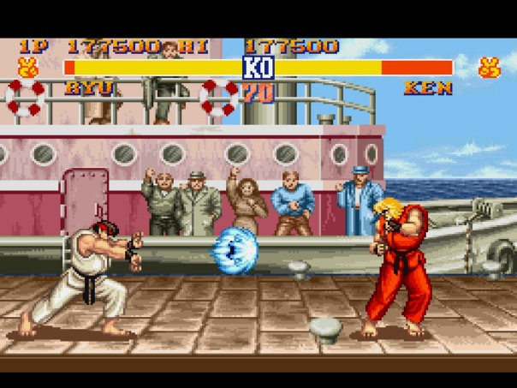
Combinations

Slide 15
Combinations
The real power of Vi comes from the fact that you can compose a lot of keystrokes into something very useful.
Let's now combine a few keys together to make combos!

Slide 16
Automate your life
With the recording feature, you can actually automate repetitive keystrokes with by recording and then playing back.
Demo time..

Slide 17
Vi Plugins
Plugins are built on top the base commands, and they provide very useful things.
Won't explore in too much detail but let's look at one plugin in action.

Slide 18
Resources
Introduction video (thx Andrew) - www.youtube.com/watch?v=p6K4iIMlou
Twitter: vimtips
Learn vim while playing a game -http://vim-adventures.com/
Vim Golf - http://www.vimgolf.com/

